Slide 1



Transferable Language
Speaking and Writing

Slide 2
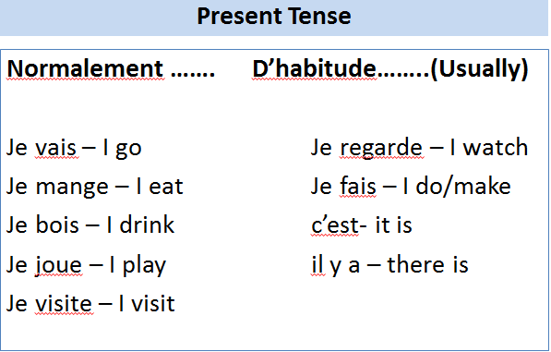
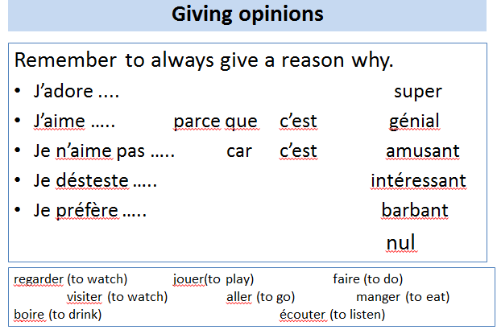
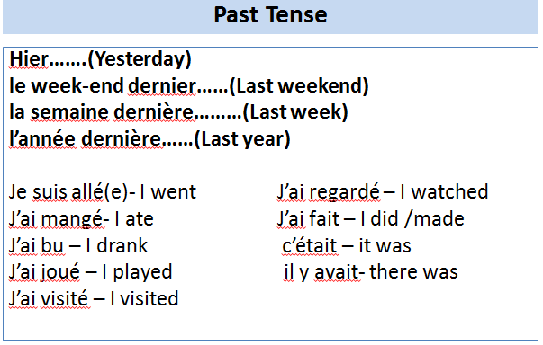

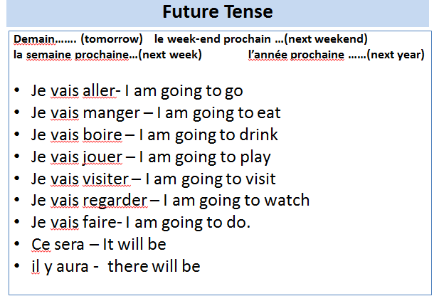
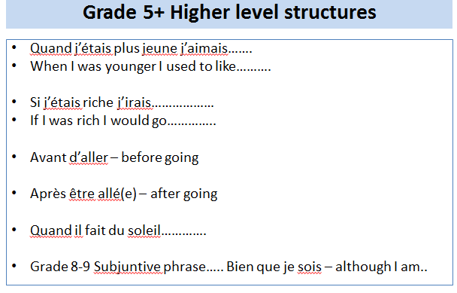
Transferable Language
Speaking and Writing

Slide 3
Quand j’étais plus jeune…..
J’aimais- I used to like
Je détestais- I used to hate
J’allais- I used to go
Verbs with infinitives
Je voudrais – I would like…
J’ai commencé à – I started …
J’ai appris à – I learned
J’ai décidé de – I decided
J’ai choisi de – I chose
Pluperfect – say what you “had been” doing when something happened.
j’avais vu – I had seen
J’avais regardé – I had watched
J’étais parti(e)- I had left
J’etais arrivé(e)- I had arrived
J’étais parti(e) quand le film a commencé – I had left when the film started.
J’étais arrivé(e) quand il a commence à pleuvoir- I had arrived when it started to rain.
aller- to go
visiter – to visit
manger- to eat
faire – to do
Avant d’aller – Before going
Avant de jouer – Before playing
Avant d’arrive- before arriving
Avant de partir – before leaving
Transferable Language
Speaking and Writing 7+
Après être allé(e) – After going
Après être arrivé(e)- After arriving
Après être parti(e) – After leaving
Après avoir mangé – After eating
Après avoir joué – After playing
Use other subjects with verbs
.
 | Present | Past | Future
aller (to go) | Je vais | Je suis allé(e) | Je vais aller
 | On va | On est allé(e) | On va aller
manger (to eat) | Je mange | J’ai mangé | Je vais manger
 | On mange | On a mangé | On va manger
jouer (to play) | Je joue | J’ai joué | Je vais jouer
 | On joue | On a joué | On va jouer
En +present participle
On doing / while doing
En arrivant- On arriving
En jouant-On playing
En entrant –on entering
En mangeant on eating
En visitant –on visiting
En allant –on going
Si j’étais riche…Si j’avais le choix……
(If I was rich…. If I had the choice….)
j’irais…… - I would go
Je visiterais - I would visit
Je mangerais - I would eat
Je jouerais - I would play
Subjunctive phrases
Bien que…. Although
Il faut que – it’s necessary that
C’est dommage que- it’s a shame that
Pour que – so that
J’aille – I go j’aie – I have
Je sois – I am je puisse – I can
Avant d’aller - Before going
Avant de partir – Before leaving
Avant de manger- Before eating
Avant de me coucher – Before going to bed.

Slide 4

Transferable Language:Speaking and Writing
Present Tense
Normalement ……. D’habitude……..(Usually)
Je vais – I go Je regarde – I watch
Je mange – I eat Je fais – I do/make
Je bois – I drink c’est- it is
Je joue – I play il y a – there is
Je visite – I visit

Slide 5
Transferable Language:Speaking and Writing
Past Tense
Hier…….(Yesterday)
le week-end dernier……(Last weekend)
la semaine dernière………(Last week)
l’année dernière……(Last year)
Je suis allé(e)- I went J’ai regardé – I watched
J’ai mangé- I ate J’ai fait – I did /made
J’ai bu – I drank c’était – it was
J’ai joué – I played il y avait- there was
J’ai visité – I visited

Slide 6
Transferable Language:Speaking and Writing
Future Tense
Demain……. (tomorrow) le week-end prochain …(next weekend)
la semaine prochaine…(next week) l’année prochaine ……(next year)
Je vais aller- I am going to go
Je vais manger – I am going to eat
Je vais boire – I am going to drink
Je vais jouer – I am going to play
Je vais visiter – I am going to visit
Je vais regarder – I am going to watch
Je vais faire- I am going to do.
Ce sera – It will be
il y aura - there will be

Slide 7
Transferable Language:Speaking and Writing
Giving opinions
Remember to always give a reason why.
J’adore .... super
J’aime ….. parce que c’est génial
Je n’aime pas ….. car c’est amusant
Je désteste ….. intéressant
Je préfère ….. barbant
nul
regarder (to watch) jouer(to play) faire (to do) visiter (to watch) aller (to go) manger (to eat)
boire (to drink) écouter (to listen)

Slide 8
Transferable Language:Speaking and Writing
Grade 5+ Higher level structures
Quand j’étais plus jeune j’aimais…….
When I was younger I used to like……….
Si j’étais riche j’irais………………
If I was rich I would go…………..
Avant d’aller – before going
Après être allé(e) – after going
Quand il fait du soleil………….
Grade 8-9 Subjuntive phrase….. Bien que je sois – although I am..

